Slide 1
Dietrich Bonhoeffer
A Short BIO
for the
Maranatha Class, BAUM
January 8, 2012
Ron Marsh
Notes:
OPENING REMARKS
Good Morning. It’s a pleasure … Since you don’t know me …
I’m a Tulsa native; married, one daughter w/3 grandchildren; and I like to play golf, fish and read.
In our short time together, I’m going to give you a brief introduction to Dietrich Bonhoeffer … Mouzon references … Sue Venable request … Pilgrimage lessons …
My plan is to show you a slide & make a few comments. I’ll try to finish the slides and give you time if you have Qs, but feel free offer Questions or Comments as we go.
Finally, I’m leaving out a lot by necessity. When we’re through I hope you have a better sense of this man who is so often quoted by Mouzon. Trust me, some of my slides will let Dietrich speak for himself but in most I’m just sharing bio information.

Slide 2
Dietrich Bonhoeffer 1906 - 1945
Theologian, pastor, musician, author, traveler; family was prominent, well-to-do, cultured
At age 14, told family he would be theologian. Rec’d doctorate (equivalent), Berlin U., 1927 @ age 21.
Highly visible efforts to save Christianity in Germany from Hitler and the Nazis.
Imprisoned 3/43 in Berlin; executed 4/45 for role in plot to assassinate Hitler.
Notes:
My information comes from:
many references on the internet
Dietrich’s writings,
PASTOR, PROPHET, MARTYR, SPY by Eric Metaxas
BTW, I think this is a wonderful biography, a riveting book and I recommend it.

Slide 3
Bonhoeffer ???
= ‘bean farmer’
Lineage dates from 1403 – Netherlands
Family moved to Schwäbisch Hall, Germany in 1513
Coat of Arms: left-facing, standing lion holding a beanstalk; on a light blue background
Still seen on public bldgs. in Sch. Hall
Dietrich’s signet ring bore crest
Notes:
DO ANY OF YOU SPEAK GERMAN?
I can’t speak or pronounce it
As to Dietrich’s family name:
I’ve heard BON’ hoffer AND BON’ hoofer
We’ve the former from the pulpit, and in the AUDIBLE BOOKS version of Metaxas’ book it was BON’ hoofer.
And most recently, Mouzon has leaned towards the BON’ hoofer.

Slide 4
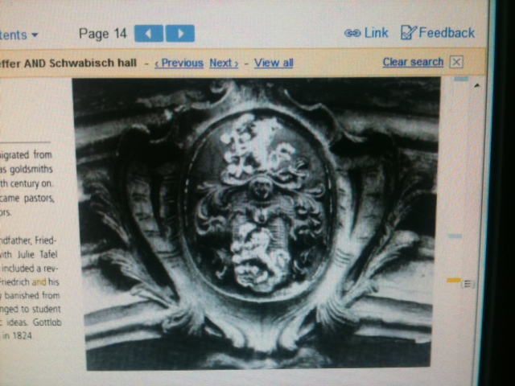
Family Crest
Notes:
This is the ONLY graphic I found and it’s on the façade of a public building in Schwabisch Hall, Germany.
Kathy would probably confirm how much I looked on the internet for the family crest.
I didn’t think it would be so tough but the ONLY visual I’ve found is fr

Slide 5
Parents
KARL – Dr. of Psychiatry & Neurology; U. Berlin dept. head. Family dates to 1400’s … prominent for 300+ years: goldsmiths, jurists, professors, municipal leaders & pastors ….
PAULA – (nee von Hase); teacher ... cultured family of musicians, artists, attorneys and religious leaders.
Notes:
Dr. Bonhoeffer was not a supporter of Freud ... He preferred more tangible things as the basis for his science.
By all accounts they were wonderful, loving parents who raised their 8 children in an educated, cultured household.

Slide 6
Family Environment
4 boys, 4 girls. Warm love … strict rules. Paula ran the household w/Karl’s full support. Not ‘religious’ per se; Paula’s Lutheran beliefs, values taught.
Children very active in sports, music, nature; loved the outdoors. Home schooled to 7-8 then Gymnasium
Staff : governess, nursemaid, housemaid, parlor maid, cook.
BTW: family anecdotes suggest the children respected, loved the staff and did not look down on them.

Slide 7
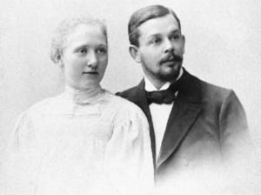
Paula & Karl 1898
Notes:
Dietrich’s parents about two years after their marriage.

Slide 8
The Sibs
Karl Friedrich 1899 (Jan)
Walter 1899 (Dec)
Klaus 1901
Ursula 1902
Christine 1903
Dietrich 1906
Sabine 1906 twin
Susanne 1909
Notes:
The eight children ….
Walter died in WWI of shrapnel wounds.

Slide 9
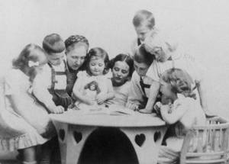
Paula & the Children
Dietrich’s ‘the blonde’ 2nd from R
Notes:
I’m not sure, but it looks like Paula is reading to her children …
And I don’t know how many times I’d looked at this picture before I noticed the ornate hearts cut into the legs of the table.

Slide 10
Young Dietrich
Keen interest in MUSIC, reading, outdoors / nature, sports (incl. fighting per his Father).
Central figure in family music (piano) and holiday productions.
At 14, told family he would be a theologian.
Notes:
Dietrich’s family was surprised when he announced he would be a theologian.
Brother Klaus (19) described the church as a “poor, feeble, boring, petty bourgeois institution”. Dietrich said, “In that case, I shall have to reform it.”
Karl-Friedrich (21) opined DB was turning his back on scientifically verifiable reality and escaping into a world of metaphysics. DB replied … paraphrased … “Even if you were to knock my head off, God would still exist!”

Slide 11
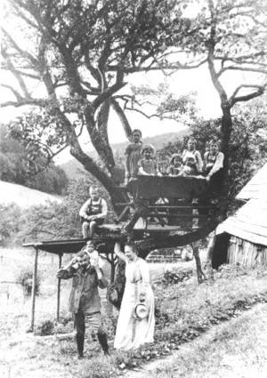
Familie at Woelfelsgrund 1911
Country retreat while living in Breslau
Notes:
Karl & Paula had country ‘retreats’ for family holidays and the summers. By way of comparison to the ‘city’ homes, the country places were spartan.
From Breslau: 2 HOURS to the South by train to the Glatz Mountains near the Bohemian border. This is a picture from what they called the ……. anyone want to try it?
The retreat from Berlin was a former FORESTER’S LODGE in Friedrichsbrunn in the Harz Mountains. (for 30 YEARS it had no electricity!) …. AND, it was a 4 MILE hike through the woods from the town.

Slide 12
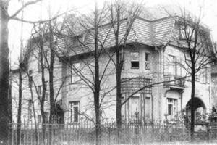
Home … When in Berlin
Notes:
And here’s the Berlin home.

Slide 13
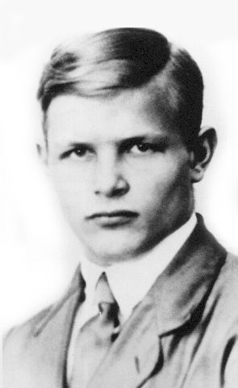
Dietrich @ 17 in College
Notes:
Handsome young man. This picture shows a serious side, and that’s probably right.
He was an over-achiever as best I can guess.
And while he was cultured and raised with ‘money’, he was generous almost to a fault.

Slide 14
College & Italy
College at Tubingen U. at 17. At 18 he sold parents on value of cultural trip to Italy (accompanied by Klaus)… Rome, Naples, Sicily.
was overwhelmed by arts / antiquity everywhere ; … ‘could hardly move beyond Adam’ (Sistine Chapel) … struck by God’s ‘colossal power and tender love’.
Palm Sunday - ‘began to understand the concept of church’ & ‘transcendence of race and national identity’.
Notes:
College for the Bonhoeffer boys was different than what it was for most of us.
The trip was a NON-STOP, SEE & EXPERIENCE everything time will allow.
BTW, like the rest of the book, Metaxas was very descriptive of this trip.
Those of you who have been to Italy would really enjoy the comments.

Slide 15
Doctor Bonhoeffer
Berlin U. at 18. Doctorate at 21 in 1927.
Strong faculty: liberal and conservative theologians. Dietrich described as ‘free, critical and independent’ theological thinker.
Chose to know about God, … rely on revelation from God. (fit w/ Luther’s doctrine of Grace).
Accepted temporary vicarage position to German church in Barcelona.
Notes:
HERE’S A QUICK BIT OF COLOR FROM DIETRICH:
Just before Christmas … I believe he was 18 or 19 … he spent the two weeks of covert military training required of all college males.
That was Germany’s way of getting around the prohibitions of the Versailles Agreement.
These college TROOPS were called: the Black Reichwehr. In Dec., after completing his two weeks, Dietrich wrote: “Dear Parents, Today I am a civilian”.

Slide 16
Berlin - 1929
After Barcelona, in Berlin for less than a year, he was:
Made eligible to lecture at University after defending his 2nd dissertation (Act and Being),
Awarded a Sloane Fellowship to attend Union Theological Seminary in NYC.
He was 23.
Notes:
This is a good example of Dietrich’s high activity level … his writing was as prolific as his thinking.
And believe me, I’ve left out all of his social interactions with family and friends.

Slide 17
America 1930-31
Sailed into NY … dazzled by harbor, sky-scrapers, pace, architecture …
it was the end of the Jazz Age … a year after the Market Crash … and
two days later (unbeknownst to DB), Hitler’s National Socialist party vaulted from 12 Reichstag members to 107 and became the 2nd largest party
Notes:
This trip was intended to be a year of study before going back to begin lecturing at university.
If only from the standpoint of his observations and their effects on his thinking, this was a momentous trip.

Slide 18
Union Theological Seminary
Very disappointed in school AND students: NO theology, no legitimate debates, no dogma. Took classes but opted to see all he could; no interest in a degree.
“ the Gospel of Jesus, the cross, sin, forgiveness, death and life” were simply absent”
Notes:
In 1930’s NYC, There was a fierce battle going on at Union between (theological) liberals and fundamentalists.
Riverside Church (liberal Rev Harry Emerson Fosdick) & Broadway Presbyterian Church (Dr. Walter Duncan Buchanan, fundamentalist) pp 103

Slide 19
American Friends Share Culture
Albert ‘Frank’ Fisher, African American, introduced Dietrich to American negro religion … would change Dietrich’s perspectives.
Saw black America’s plight, and the spirituality from NYC to DC to the deep South.
took DB to Abyssinian Baptist Church (Harlem) … 14,000 mbrs … built on tithes … DB taught SS class to teen boys.
At home in Germany, DB would see the similarities to how Nazis treated the Jews.
Notes:
This and the next slide deserve more emphasis and stronger words than time permits.
Let me just say that Dietrich was ENORMOUSLY effected by the spirituality he found in the Negro American congregations … from their caring for each other to their spirituals.
He was in sync with them from day 1 !!!

Slide 20
Visibility Increases: Berlin ‘31-’33
Back in Germany …. with Hitler & Nazi presence heightening … Dietrich picked up tempo and visibility.
preached more often and severely . He noted
  ‘… the Protestant Church in its 11th hour …’
  ‘… wake up and stop playing church …
friends sensed DB’s faith had deepened ; his sense of … self being called by God was becoming clearer
Notes:
This is mostly ’32 and back in Germany.
Dietrich couldn’t STAND, couldn’t ABIDE what he saw happening to the Church in Germany.
I suspect that you have a larger sense of what was happening than you might suppose:
Hitler was beginning to make the Church subservient to HIMSELF
Jews were being targeted in every way possible
Things like the Feuhrer Principle, the Aryan Paragraph , Kristalnacht
Dietrich saw the Church was under attack and at risk of being eliminated in any true form from Germany.
I think it’s important for you to get a sense of how this incredible theologian / academician was changing.
And I think you’ll be surprised.

Slide 21
Dietrich re Self c. 1933
LETTER to Elizabeth Zinn describing self … “
I plunged into work in a very unchristian way. (ambition)
FOR THE FIRST TIME I DISCOVERED THE BIBLE … I had often preached. I had seen a great deal of the Church, and talked and preached about it – BUT I HAD NOT YET BECOME A CHRISTIAN.
… I had turned the doctrine of Jesus Christ into something of personal advantage for myself …
I pray to God that will never happen again. Also I HAD NEVER PRAYED, OR PRAYED ONLY VERY LITTLE.”
Notes:
Please read this and the next three slides ….
Think back to when I commented about Dietrich’s intellect (which was huge) was more academic, more scholarly.
This is where I was alluding to changes coming … and not just changes in Germany, but IN him.
WHAT DRAMATIC COMMENTS TO MAKE TO A FRIEND.

Slide 22
Dietrich Continues - 1933
“ ... For all my loneliness, I was quite pleased with myself. Then the Bible, and in particular the Sermon on the Mount, freed me from that.
…. It became clear to me that the life of a servant of Jesus Christ must belong to the Church, and step by step it became plainer to me how far that must go.
… Then came the crisis of 1933. … This strengthened me in it. Also I now found others who shared that aim with me. The revival of the Church and of the ministry became my supreme concern …
continued ….
Notes:
Of course, it was the SERMON ON THE MOUNT that was the thesis of his The Cost of Discipleship . In German, Nachfolge
It sounds like Dietrich saw all that was happening around him, and it effected him to the core of his spiritual foundations.

Slide 23
Dietrich Continues re Self - 1933
“ ... My calling is quite clear to me. What God will make of it I do not know … I must follow the path. Perhaps it will not be such a long one (Phil 1:23). But it is a fine thing to have realized my calling … I believe its nobility will become plain to us only in coming times and events. If only we can hold out. “
Dietrich became a regular churchgoer for the first time in his life and took communion as often as possible.
Notes:
When you read them, these are really STRIKING observations.
I’m certainly a neophyte in terms of Dietrich Bonhoeffer, but it sounds like quite a change was going on ….
remember, Dietrich had concluded the people that make up the church ARE THE BODY OF CHRIST.

Slide 24
Dietrich’s Guidance
“ … when you read the Bible, you must think that here and now God is speaking with me.”
“I believe that the Bible alone is the answer to all our questions, and that we need only to ask repeatedly and a little humbly, in order to receive this answer. One must be prepared really to enquire of it. Only thus will it reveal itself.”
Notes:
He continued …..
Now this sounds something like what we might hear from a pulpit …
I suspect each of us have our own take on what Dietrich is saying … and that it effects each of us a little differently.
As we move to the next slide, put yourself in a Dietrich mindset …. think like he thought as he made these comments and then consider what Dietrich faced, what he felt about what was happening in his country … and to his Church.

Slide 25
German Christianity’s Change
Hitler’s Deutsche Christen practiced positive Christianity (i.e. defeat godless & degenerate forces of Bolshevism) & opposed all who didn’t agree w/them.
The Aryan Paragraph said employees must be of Aryan stock. Jewish descent = job & status loss.
  - all pastors w/Jewish blood would be excluded from ministry.
Notes:
This is what Dietrich faced. The Church, as he knew it and loved it, was changed to be Hitler’s …. not God’s.
For Hitler to succeed, he needed (and he required) absolute support of the church. He achieved that by requiring mainstream religions to adopt the Aryan Paragraph.
Somewhere I read the description of this period. It said: Democracy was murdered and lawlessness became legal. The Nazis ruled, unchecked and with raw power.

Slide 26
Dietrich’s PEACE SPEECH
Given at the closing of the ecumenical conference on 8/28/34 at Fano, Denmark. He said:
“ … Peace means giving oneself completely to God’s commandment, wanting no security, but in faith and obedience laying the destiny of the nations in the hand of Almighty God, not trying to direct it for selfish purposes. Battles are won, not with weapons, but with God. They are won when the way leads to the cross.”
Notes:
This ecumenical counsel was attended by pastors from across Europe. They tried to come to terms w/how to cope with Hitler.
And, again, Dietrich does not stand by and watch. He’s totally committed to ACTION to safe the Church.
As I read about Dietrich … and as I read Dietrich … I was always looking for what supported his decision to join the German resistance effort to assassinate Hitler.
I don’t see THIS as the answer. I do think it kind of points to the future … and we’re not there yet.
pp 241

Slide 27
Underground Seminary 4/35
Rather than swear allegiance to Hitler, the Pastors’ Emergency League was formed. Out of that came a group of clergy who would not accept Hitler’s taking over the Church. And Dietrich was named to lead an underground seminary, to train pastors; began in ‘35.
  Begun at Zingst near the shore; moved to Finkenwalde in Pomerania.
  Closed by Gestapo in ‘37; 27 seminarians arrested
  Dietrich continued preparing pastors into ‘39
  Two of Dietrich’s major works came from this period:
The Cost of Discipleship
Life Together
Notes:
Does anyone know what the term ‘confessing church’ means? In plain language, it was taken from a Latin phrase, and meant … there comes a time when the Church has to speak up for what’s right (God’s way).
… what he was making happen to try to save the church.
The pastors who joined the League, and it was a large number, agreed to 4 points:
Signers would rededicate themselves to the scriptures and to the previous doctrinal confessions of the Church
would work to protect the church’s fidelity to scripture and to confession
3 would lend financial aid to those being persecuted by new laws or by any kind of violence
they would firmly reject the Aryan Paragraph

Slide 28
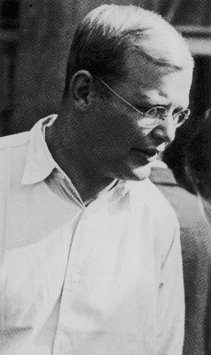
Dietrich at 29 (1936)
Notes:
I don’t know the event of this picture. I put it in to show how he’d aged over 6 or 7 years (since Barcelona).
To support the seminary, Dietrich raised funds from supportive, moneyed Christians in Pomerania. One lady, Ruth von Kleist-Retzow, was a strong supporter of Dietrich. She was also the grandmother of Maria von Wedemeyer.

Slide 29
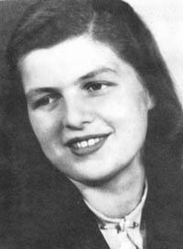
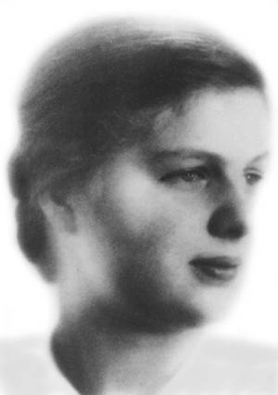
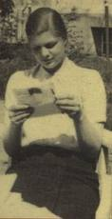
Maria
Notes:
These are the only three pictures I found of Maria.
On the right, in 1942, she was 18 and probably very much the person Dietrich saw.
FYI, she was born 4/23/24 vs. his being born in 1906.

Slide 30
Hitler’s WAR PLANS Spark Action
NOV ’37 Generals stunned by scope, violence and madness when Hitler presented war plans.
THREE major plots undertaken to kill Hitler . [OPERATION FLASH, OVERCOAT, STAUFFENBERG (which only injured his arm … Hitler would claim that was providence.
‘41 - Dietrich persuaded to join plot(s) as agent of ABWEHR; traveled Europe widely seeking aid for ‘resistance’ group.
Dietrich opted to keep engagement to Maria a secret.
Notes:
So we don’t lose sight of this being about Dietrich, we need to pick up the tempo.
Hitler is almost at full speed and we’re not going to retrace the war. The men he counted on to conquer all of Europe and then look around for what’s next, balked … some began to realize they’d been hoodwinked.
Hitler ANNEXED Austria. Various of his officers wanted to invade Czechoslovakia NOT because they bought into his megalomania, but because they thought it would give them an opportunity to seize Hitler and take over the government.
And, as we know, it didn’t happen that way.

Slide 31
The Spy
Feb ‘42 - DB & Hans Dohnanyi learned Gestapo watching them … phones tapped, mail intercepted.
Even letters to family written in (family designed) codes.
Gestapo interrogated Wilhelm Schmidhuber re currency smuggling. He implicated Dohnanyi and Bonhoeffer in a plot against Hitler.
Notes:
Hans Dohnanyi was an attorney, a friend of Dietrich, and had become the personal assistant to the Reich Minister of Justice in Berlin. As a result he was very much in the know, and was one of the leaders of the conspiracy Dietrich had joined.
With all of my reading, I still can’t fathom what Dietrich thought, what he was facing, what he was being called to do.
We do know he felt he was ‘called’, that he was sure it was better to resist evil than to be evil,
that one could not avoid incurring guilt, but he was ready to face God for his actions.

Slide 32
Cell 92, Tegel Prison
Engaged to Maria in January … JAILED by the Gestapo 4/5/43; would spend 18 mos @ Tegel.
Also arrested that day:
  Hans Dohnanyi (Abwehr, conspiracist)
  Joseph Muller (Abwehr, conspiracist) & his wife
  Christine Bonhoeffer (sister, conspiracist)
  Treated as a felon first 12 days … but w/o being told charges.
Notes:
In late ‘42, Dohnanyi knew from their sources, their connections, the Gestapo was picking up the tempo of their investigation of the Abwehr.
They had actually picked up the trail on Dietrich back in October through the interrogation of a courier moving currency for the Abwehr.
Without our dwelling on them, Dietrich documented the dirty, brutal conditions of Tegel. including his being denied his civil rights.
Cell 92 on 3rd floor, overlooked prison yard out to a pine forest. 7’ X 10’ w/plank bed, a bench, a stool, a necessary bucket, a wooden door w/circular window for observation , and a window above head-high for light and fresh air.
Tegel was 7 mi from Dietrich’s parents’ home. They visited him often and brought him such gifts as were permitted.

Slide 33
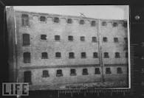
Tegel Prison
Notes:
This was Dietrich’s first cell. Within a couple months he was moved to a more comfortable cell
And the next slide shows that cell.

Slide 34
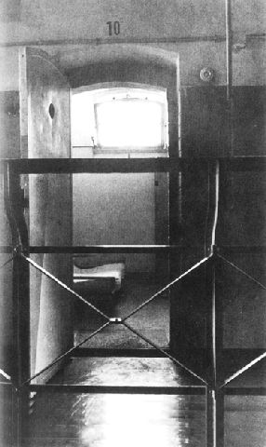
CELL 92

Slide 35
Tegel Prison Perspective
daily prayers, meditation, writing; guards befriended; cell left open for guards & fellow prisoner access.
could write / receive one-letter/10 days; guards snuck others in/out (200 pages 11/43 - 8/44 to Eberhard Bethge alone)
Family visits (wkly as permitted) and Maria (17 over 18 mos)
Allowed NO self-pity; was repulsed by it in others.
Gave opportunity to escape to another prisoner.
Notes:
Dietrich’s writings were read … by Manfred Roeder, his prosecutor.
Letters were written on two levels with one having meanings only family and close friends would understand.
The ‘43 arrest was NOT for the conspiracy efforts. It was for money-laundering. You see, the Nazis couldn’t imagine that the money was being used to help fleeing Jews.
Only LATER, after the failed Stauffenberg bomb plot, would he be incriminated for being in the conspiracy to kill Hitler.
In the mean time, every effort was made to portray Dietrich as an innocent pastor … their spy craft notwithstanding.

Slide 36
Fallout of 7/20/44 Bomb
Everyone remotely involved in the conspiracy was arrested / interrogated; many were tortured.
Trials in the People’s Court were perfunctory
Gen Paul von Hase (Dietrich’s uncle in Paula’s family,) sentenced / hung Aug 8.
Hans Dohnanyi’s files & records seized 9/20/44; his fate & Dietrich’s were sealed from that point on.
Notes:
Hitler created PEOPLES’ COURT in ‘34 to try cases of treason.

Slide 37
The Road to Flossenbürg
From Tegel prison, where he spent 18 months, it was just a question of time before he would be one of the victims of the assassination investigations ...
Oct 8, 1944 - moved to Gestapo prison - Berlin
Feb 7, 1945 - to Buchenwald (en route to Flossenbürg)
Apr 8, 1945 - Arrived Flossenbürg Sunday evening. Was sentenced then executed Mon morning, 4/9.
Notes:
In the Gestapo’s prison, Dietrich was not tortured. Most were.
It’s theorized that with Germany’s ultimate and impending defeat becoming more clear, some prisoners were seen as valuable chips for negotiations and peace-feelers.
Dietrich was allowed to write to Maria on 19 Dec 1944. He was upbeat, forward-looking and tenderly loving. He told her, “Don’t lose heart.” He asked her to give his love to his Mother and family (with whom she was living)…and told her he was enclosing a poem he’d written called POWERS of GOOD. It ultimately came to be sung as a hymn in churches, and appears in many school textbooks.
Two weeks after Dietrich’s execution, the Allies marched into Flossenburg. The next week, Hitler committed suicide.

Slide 38
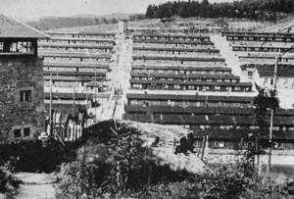
Flossenbürg Prison
Notes:
Flossenburg was not really a prison per se …. it was a concentration camp.

Slide 39
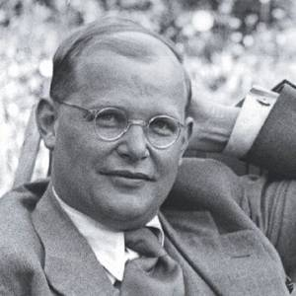
Thank you, Dietrich
1906 - 1945
“This is the end . . . For me the beginning of life.”
Notes:
Thank you for letting me give you this short introduction to Dietrich. It’s been my pleasure and I can only tell you that we could spend hours on this great man’s life, writings and teachings.

