Slide 1
Community Profile 2013
Tulsa County
Commissioned by the
Metropolitan Human Services Commission
Prepared by the Community Service Council
January 2013
Notes:
The needs assessment has been commissioned by the JumpStart Tulsa and prepared by the Community Service Council of Greater Tulsa.
The data is compiled from the US Census Bureau for 2000 and 2010, the American Community Survey 2009-2011, the vital statistics of the Oklahoma State Department of Health, the Department of Human Services Monthly Bulletins and Annual Reports and the Oklahoma Department of Commerce. All references are included at the bottom of the graph.

Slide 2

tulsa County
Demographic Trends
Economics and Employment
Health Indicators
Demographics
Notes:
The needs assessments for Tulsa County includes demographic trends, economic indicators and employment trends as well as child indicators. Child indicators will be specific to age and referenced in each slide. Some data is compiled in group data for children less than 5 or less than 6 or by specific years as available.

Slide 3
DEMOGRAPHIC TRENDS

Slide 4
Demographic Trends
Population change--migration to suburban areas of Tulsa and Oklahoma City MSA with an overall decrease in new births
Age--aging population
Race and ethnicity--more culturally diverse
Living arrangements--transitional for family living arrangement
Demographics
Notes:
Tulsa County is experiencing a number of demographic trends that are reflected both locally and in the rest of the state.
The population of rural counties is diminishing with people moving to urban areas of Tulsa and Oklahoma City for access to jobs.
The overall birth to women of our state has increased in recent years due to the Hispanic population growth.
The population is aging with a continued trend of the proportional decrease in children less than 18 and less than 5 years old.
The county and state are becoming more culturally diverse with a rapid growth population of people of Hispanic Origin.
The living arrangements of families are becoming more single headed households, and other relatives who are assuming long term guardianship of the children.

Slide 5
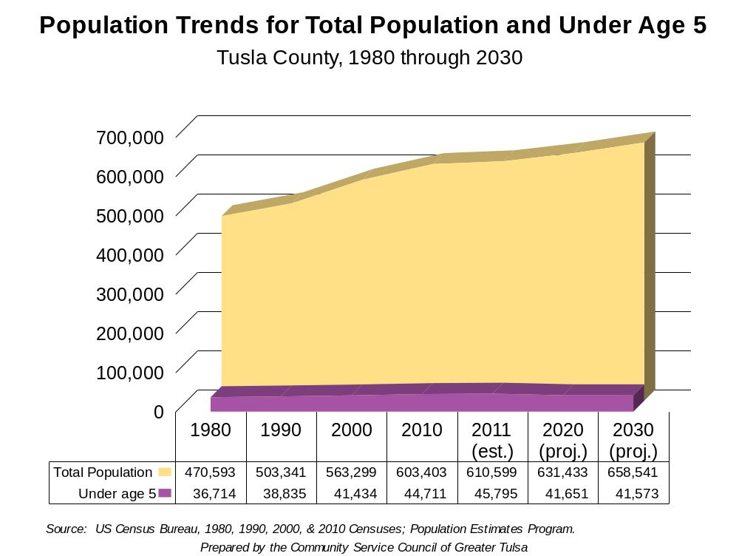
Demographics
Notes:
From 1980 to 2010, the population in Tulsa County increased from 470,593 in 1980 to 603,403 in 2010. This is an increase of 28.2%. During the same time period, the population in Oklahoma increased from 3,025,290 to 3,751,351 in 2010, a change of 24.0%.
In Tulsa County, the population of children under the age of 5 years old increased from 36,714 in 1980 (7.8% of the population) to 44,711 in 2010 (7.4% of the population).
For 2010, the population percentage of children under the age of 5 for the state of Oklahoma was 7.0%, which decreased from 7.7% in 1980.

Slide 6
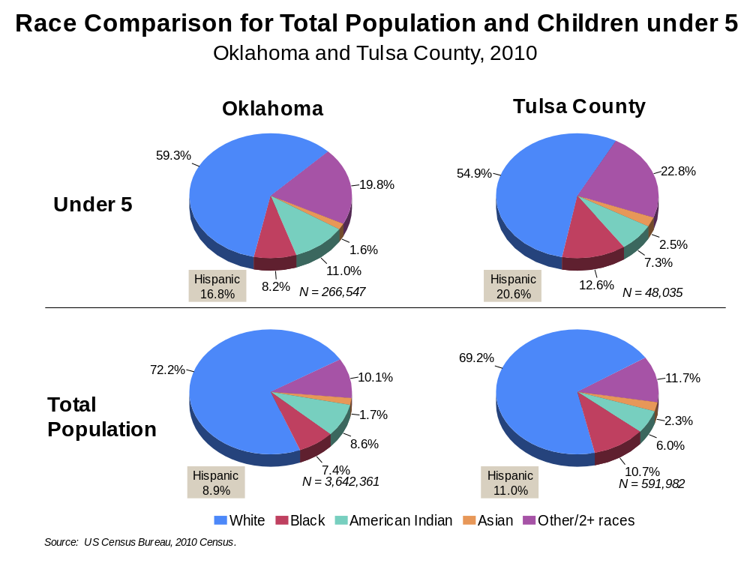
Demographics
Prepared by the Community Service Council of Greater Tulsa
Notes:
***Graphs would have been incomplete if I updated to 2011 estimates (i.e. no Hispanic or American Indian population data would be included)***
The Tulsa County population is reported with continued growth of the Hispanic population from 6.0% in 2000 to 11.0% in 2010 for the total population and a growth from 10.4% in 2000 to 20.6% in 2010 for the population less than 5 years old.

Slide 7
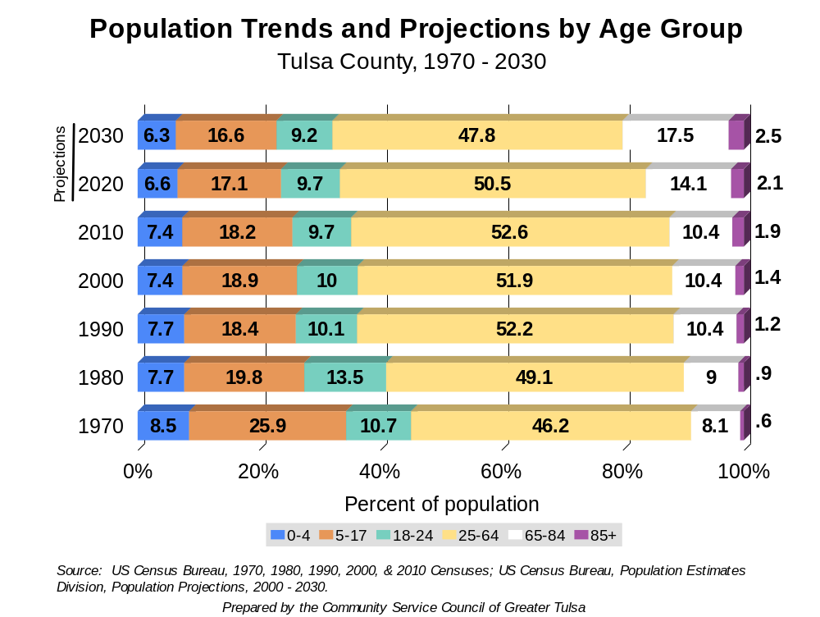
Demographics
Notes:
As I mentioned before, our population is getting older from both the young population shrinking and the older population growing. In fact, another flip is approaching – by 2014, projected that there will be more people 55+ than <25 in Ok;
First of baby boomers entered into 65+ gang this year – 2010; last of baby boomers will enter around 2030; so that progression of baby boomers along with fact that people are living longer explains the explosion of the older pop.
Why is this important? Deteriorating working age pop relative old and young – the dependent pop. In 1938 (year SS was created), dependency ratio was 17.5 to 1 – meaning that there were 17.5 workers for every dependent. Anyone know what today’s ratio is? 2.7 to 1.
And why does this matter? – 2 reasons – medicare and social security and not enough tax money coming into system to keep those afloat. Medicare will become insolvent before SS because cost of health care has risen so dramatically in past 15 years. Ss is now temporarily insolvent due to recession, but aside from that is will stay solvent til about 2040.
Ss was created in 1938 when life expectancy was 67 and retirement age was 65, so on average, people only drew ss for a couple of years. Now life expenctancy is what? 76 for men, 82 for women; and for children born in 2000 life expectancy is 100.
Ss was designed as a pay as you go system, whereby today’s workers pay for today’s retired. So its easy to see why ss is running low.
So what is the solution? 3 options – 1) we have more children to start rebuilding the working pop, 2) increase our workforce by allowing more immigrants, or 3) delay retirement….
Most industrialized nations are in same boat; do you remember hearing about russia’s national conception day a few years ago (2007)? Everyone was to try to conceive a baby. Big celebration and bonuses for those who had a baby 9 months later!

Slide 8
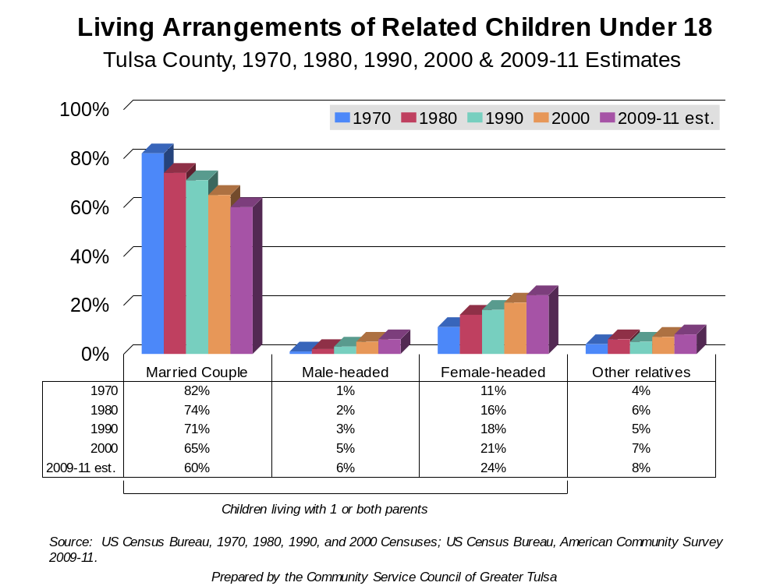
Demographics
Notes:
Growing trend of being unmarried, with or without children.
But this doesn’t necessarily mean there’s no significant other in the picture or even living in the household.
In 2008, 51% of women 15+ considered themselves single; prior the majority were married; again this does not mean they’re not in a relationship with a man.
The need for a woman to enter in to a civil or religious union has deteriorated – due to women earning higher wages and other than income taxes, a woman is more likely to qualify for a variety of services if she is single (eg, TANF).
The negative of single parenthood is that often it translates in to lower family income.
OK ranks 4th in grandparents raising grandchildren – major reason is our high rate of incarceration of women; we have ranked #1 for the past 10 years all except for 1 year when Texas out incarcerated us.

Slide 9
Economics and Employment

Slide 10
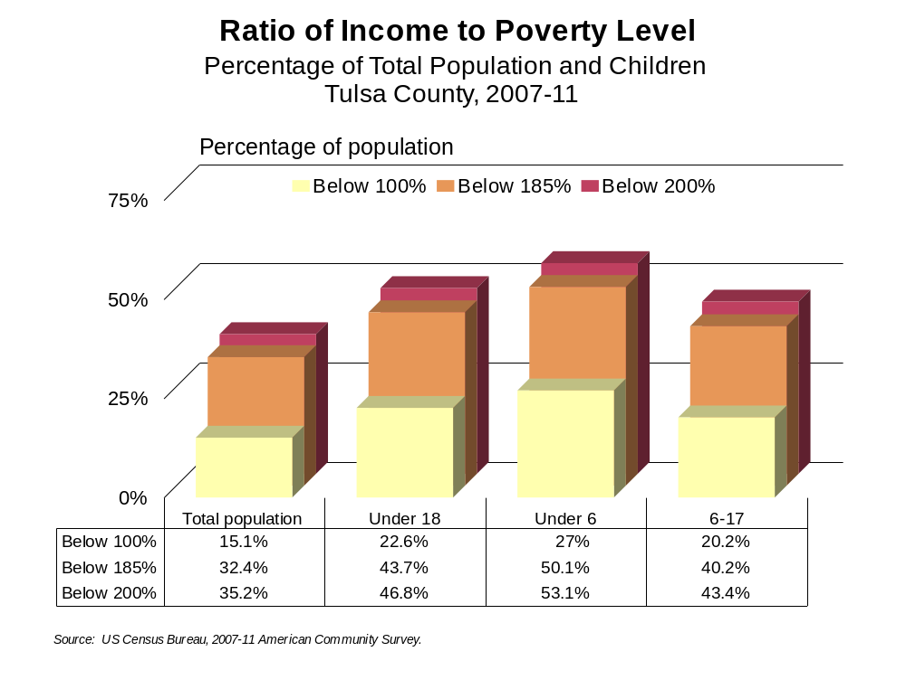
ECONOMICS & EMPLOYMENT
Notes:
***Did I need to add a slide for comparison to state data?*** The next two charts will look at the percentage of people in poverty by four target groups: the total population, children under age 18, children under 5 years old and children 5-17 years olds. The two graphs will look at Oklahoma as a whole and the second Tulsa County specifically. The federal government considers less than 200% FPL as low income.
For the total population of Tulsa County, 15.1% are below 100% FPL, 32.4% are below 185% FPL and 35.2% are below 200% FPL.
For children under age 18 in Tulsa County, 22.6% are below 100% FPL, 43.7% are below 185% FPL and 46.8% are below 200% FPL.
For children under age 6 in Tulsa County, 27.0% are below 100% FPL, 50.1% are below 185% FPL and 53.1% are below 200% FPL.
For children 5 through 17 years of age in Tulsa County, 20.2% are below 100% FPL, 40.2% are below 185% FPL and 43.4% are below 200% FPL.
In Tulsa County, just over half of all children less than 6 years of age are considered poor by the federal government.

Slide 11
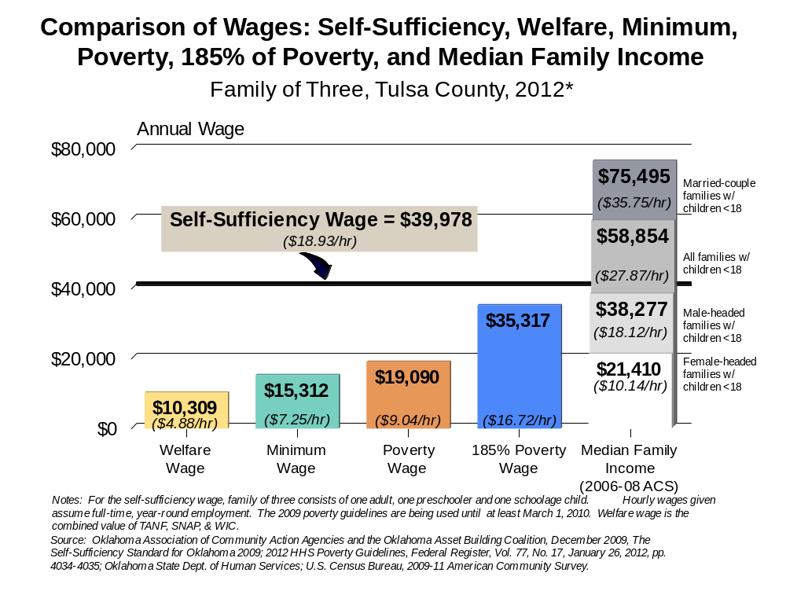
Economics & Employment
Notes:
11
In examining the comparison of wages, it is necessary to look at the enormity of the gap between attained income and self-sufficiency. The bar graph demonstrates the comparison of welfare wage (TANF support and food stamps), minimum wage, poverty wage, the median family income for a female-headed household of three persons, 185% of poverty which is the most generous federal program (Medicaid), and the “gap” between these supports and the self-sufficiency wage for a three person family. This “gap” has been growing since 1976.
Minimum wage was the federal governments legislative effort to close the gap between a self-sufficient income and need for public and private assistance in 1938. Working poor employed at minimum wage was intended to be the threshold of livable income. 1976 was the last year that minimum wage annual income and self-sufficiency were the same threshold. As a result, families have had to determine priorities for personal expenditures and seek public and private support to meet expenses that their personal income could not afford (Bureau of Labor Statistics, 2002)

Slide 12
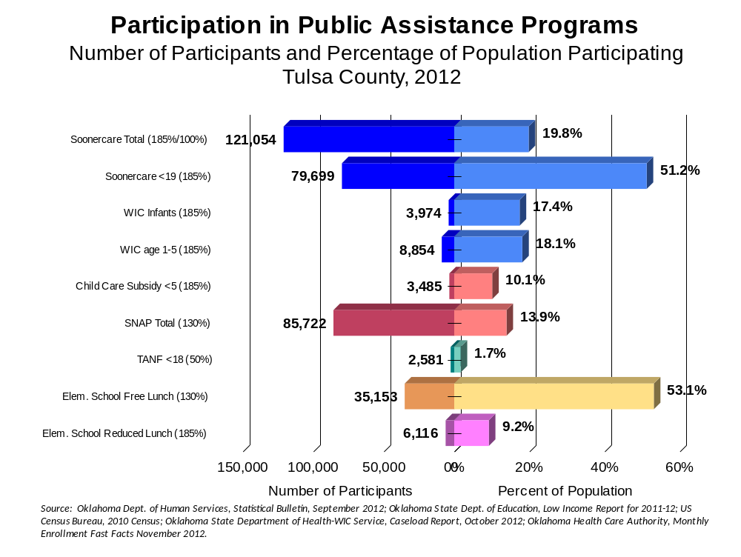
Economics & Employment
Notes:
***Original notes had Soonercare enrollment for children under 5. I’m not sure where to get that percentage.*** The participation in public assistance program of the people of Tulsa County is a more sensitive measure of the economic stresses in the community then are the unemployment statistics. In Tulsa County (September 2012), 51.2% of children 18 and under were on Soonercare, 13.9% of all county residents accessed food stamps some time during that month, and 62.3% of elementary school children were on the free and reduced lunch program.

Slide 13
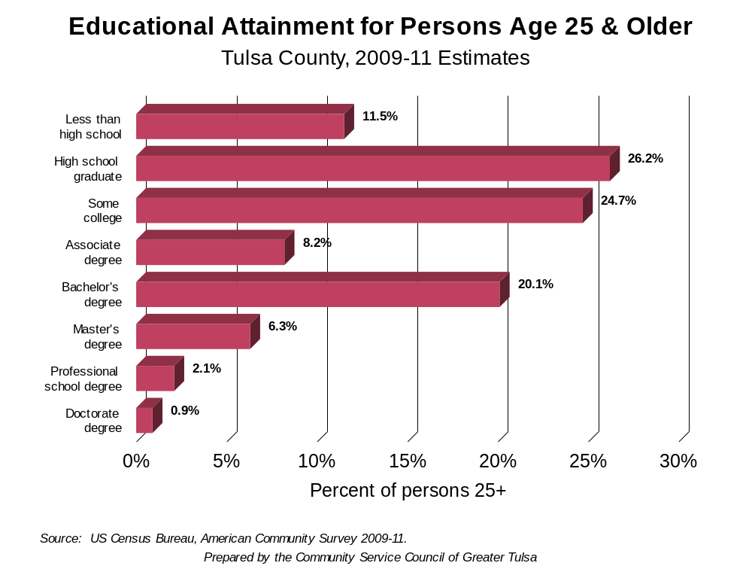
Economics & Employment
Notes:
In examination of the education attainment for persons age 25 and older, 37.7% of the population of Tulsa County have a high school education or less compared to the 45.6% at the state level (2009-2011 ACS estimates). This is an improvement from 2000 census data (41.5% Tulsa County, 50.9% Oklahoma).
The low education attainment of the persons 25 and older in Tulsa County contributes to the high poverty rate. In Tulsa County, education attainment indicates that 29.4% have a bachelor’s degree or higher in 2009-2011 compared to 23.1% for the state (improved slightly from 26.9% and 20.3% respectively in 2000).

Slide 14
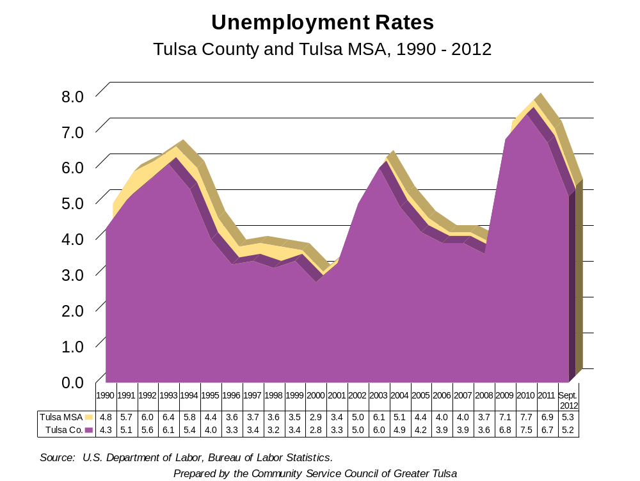
Economics & Employment
Notes:
The unemployment rates for Tulsa County have been variable but relatively low from 1995 to 2012, with a slow decline since 2010. The increases in unemployment were relatively small for the amount of economic downturn our community faced with the re-organizations, scandals and bankruptcies of oil, gas and telecommunications industries, and the “Great Recession.” Although the numbers seem dramatic, when the federal government examines unemployment, they consider 5% or less full employment, which Tulsa County and Oklahoma are once again approaching. However, in Tulsa County, the unemployment rates do not fully document the significance of the downturn. Other indicators such as the reduction in child care subsidy, and the increase in Medicaid and food stamp usage paint a different picture.
It has been speculated that the unemployment of Tulsa County has been people of middle and upper income. As a result, many due to pride or prejudice have not sought unemployment but rather a “head hunter” (professional employment consultant).
The low unemployment figure also may be contributed to by the number of people who have exhausted their unemployment and no longer would be included in these numbers.
The unemployment rate for the state in September 2012 is 5.2% which indicates that Tulsa County is on par with the state, also at 5.2%.

Slide 15




Child Indicators

Slide 16
Why are children at risk?
Lack of health insurance
Limited access to preventative services
Living in high risk families
Living in a state with a high level of premature death
Child Indicators
Prepared by the Community Service Council of Greater Tulsa
Notes:
The following graphs will look at a number of indicators of child health and social well-being for children in Tulsa County.

Slide 17
The Adverse Childhood Experiences (ACE) Study
Major American research project that poses the question of whether and how childhood experiences affect adult health decades later
Provides compelling evidence that:
  Adverse childhood experiences are surprisingly common
  ACE’s happen even in “the best of families”
  ACE’s have long-term, damaging consequences
Findings reveal powerful relationships between emotional experiences as children and physical and mental health as adults
Child Indicators
Source: The Adverse Childhood Experiences Study website: www.acestudy.org, “About the Adverse Childhood Experiences Study.”
Notes:
Adverse Childhood Experiences is a study released by Robert Anda, MD and Vincent Felitti, MD in 1998. It has received renewed interest in 2006 as a conceptual model to examine the potential for changes in well-being through the life cycle of the child. It is not considered a predictive model as yet. The implications for our state are dramatic with the large number of children experiencing child abuse and neglect, incarcerated parents, single parenting, as well as other negative indicators. To understand the risk children have in Tulsa County, the indicators of adverse childhood experience will be compared.

Slide 18
The Adverse Childhood Experiences (ACE) Study Pyramid
Early Death
Disease, Disability and Social Problems
Adoption of Health-risk Behaviors
Social, Emotional and Cognitive Impairment
Disrupted Neurodevelopment
Adverse Childhood Experiences
Death
Child Indicators
Conception
Mechanisms by which Adverse Childhood Experiences Influence Health and Well-being throughout the Lifespan
Source: The Adverse Childhood Experiences Study website: www.acestudy.org, “About the Adverse Childhood Experiences Study.”
Notes:
Implications for the study, indicate that children who experience adverse childhood trauma may have disrupted neurodevelopment which increases their risk for school failures and ultimately poorer well-being thought out the life span including greater incidences of premature death.

Slide 19
Adverse Childhood Experiences…
…growing up in a household with:
Recurrent physical abuse
Recurrent emotional abuse
Sexual abuse
An alcohol or drug abuser
An incarcerated household member
Someone who is chronically depressed, suicidal, institutionalized or mentally ill
Mother being treated violently
One or no parents
Emotional or physical neglect
Child Indicators
Source: The Adverse Childhood Experiences Study website: www.acestudy.org, “What are Adverse Childhood Experieinces (ACE’s).”
Notes:
The Adverse Childhood Experiences described by Anda and Felitti which correlate with less well-being include
Recurrent physical abuse
Recurrent emotional abuse
Sexual abuse
An alcohol or drug abused in the household
An incarcerated household member
Some who is chronically depressed, suicidal, institutionalized or mentally ill
Mother being treated violently
One or no parents
Emotional or physical neglect.
Anyone may be traumatic into itself to create changes in neurodevelopment, but the increase in the number of adverse childhood experiences increases the correlation with negative lifetime outcomes.

Slide 20
…Lead to Health-Risk Behaviors…
Smoking
Overeating
Physical inactivity
Heavy alcohol use
Drug use
Promiscuity
Child Indicators
Source: The Adverse Childhood Experiences Study website: www.acestudy.org
Notes:
The study indicated that when more adverse experiences exist a great likelihood of health risk behaviors ere documented, particularly
Smoking
Overeating
Physical inactivity
Heavy alcohol use
Drug use
Promiscuity.

Slide 21
…Which Cause Disease, Disability and Social Problems in Adulthood
Nicotine addiction
Alcoholism
Drug addiction
Obesity
Depression
Suicide
Injuries
Unintentional pregnancy
Heart disease
Cancer
Chronic lung and liver disease
Stroke
Diabetes
Sexually transmitted diseases
Child Indicators
Source: Felitti, Vincent J., “The Relationship of Adverse Childhood Experiences to Adult Health: Turning gold into lead;” CDC Media Relations, May 14, 1998, “Adult Health Problems Linked to Traumatic Childhood Experiences.”
Notes:
The health risk behaviors increase the likelihood of acute and chronic disorder which lead to increased disability and premature death.

Slide 22
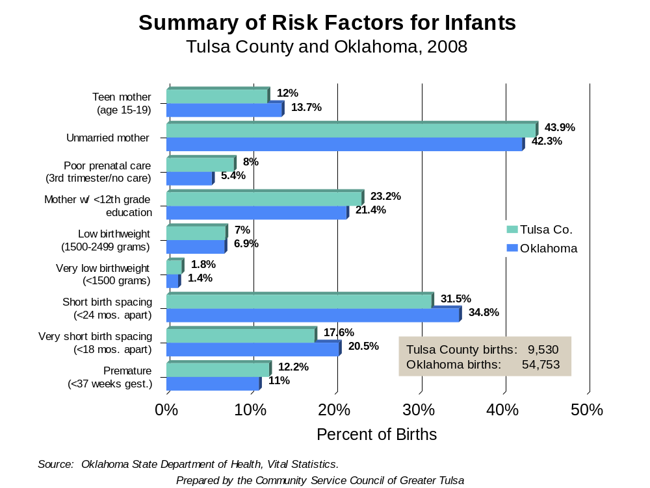
Child Indicators
Notes:
In Tulsa County (2008), there were 9,530 births. This is 17.4% of all resident births in Oklahoma. The data reveals that Tulsa County had a teen birth rate of 60.1 per 1,000 females age 15-19 years of age compared to 57.8 for the state. In all risk categories except teen births, short and very short birth spacing, Tulsa County statistics were worse than the state statistics.

Slide 23
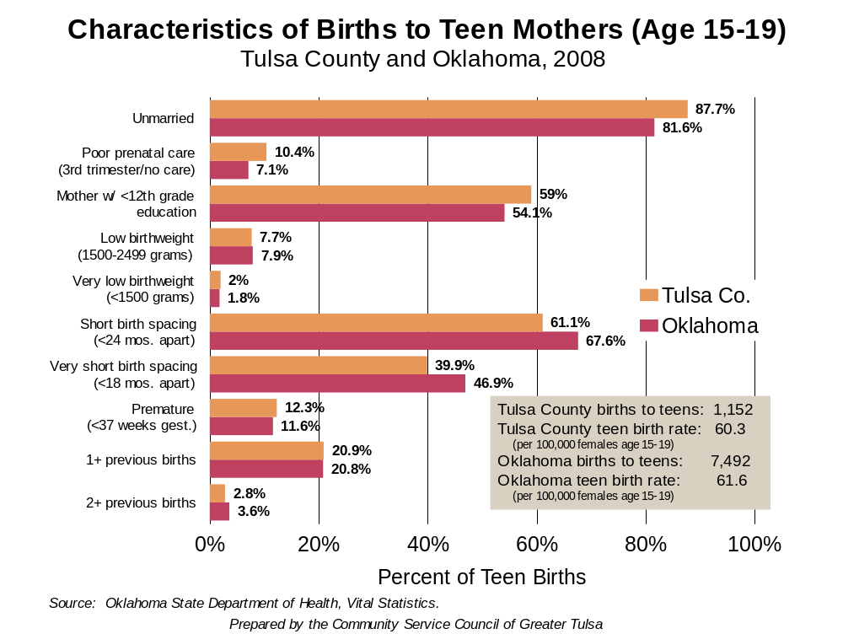
Child Indicators
Notes:
***2008 is the most recent year that is finalized- Do you want estimated?***The risk indicators for teen mothers aged 15 to 19 years were mixed. Although Tulsa County has a very high teen birth rate, the number of teens married were better than for Oklahoma.

Slide 24
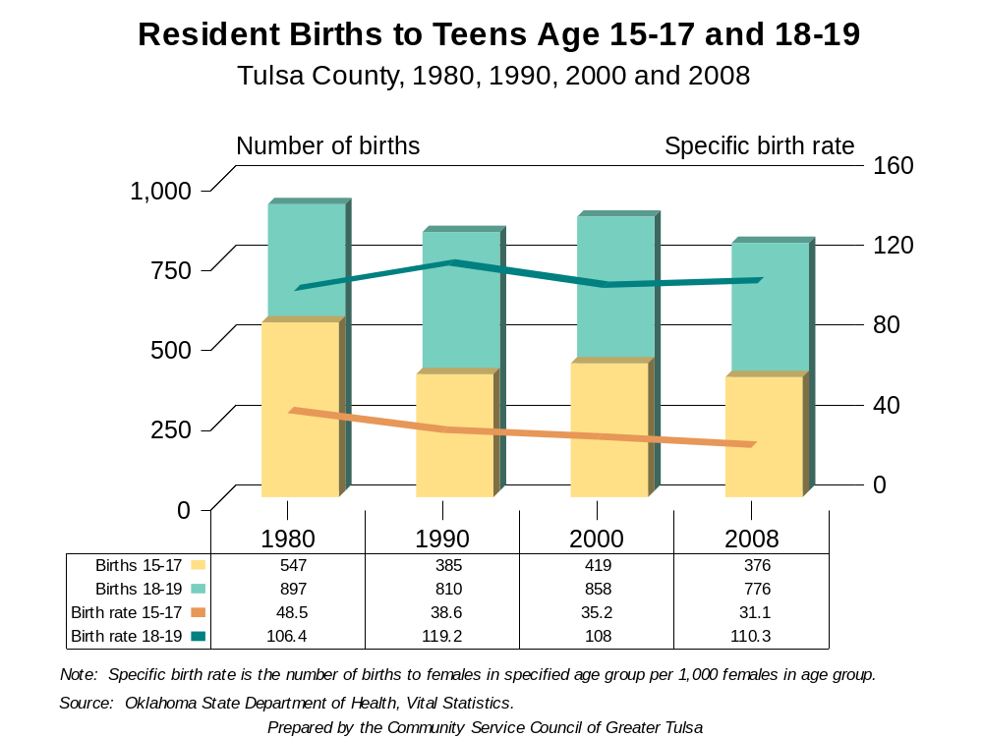
Child Indicators
Notes:
***2008 is the most recent year that is finalized- Do you want estimated?***The resident births to teen aged 15 to 19 years have decreased. The number of 18 to 19 years have numerically remained relatively the same. The rate for 18-19 years olds has increased from 1980 to 2007 and decreased for females 15-17 years olds.

Slide 25
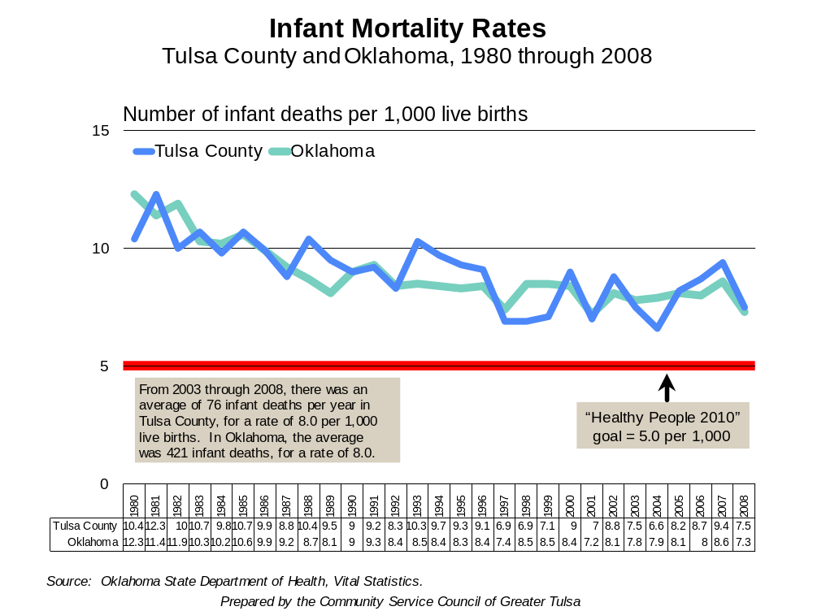
Child Indicators
Notes:
***2008 is the most recent year that is finalized- Do you want estimated?***The infant mortality rate for resident births in Tulsa County (7.5) is slightly worse than the state (7.3) with the Healthy People 2010 goal of 5.0 (and the Healthy People 2020 goal of 6.0) a distance away.

Slide 26
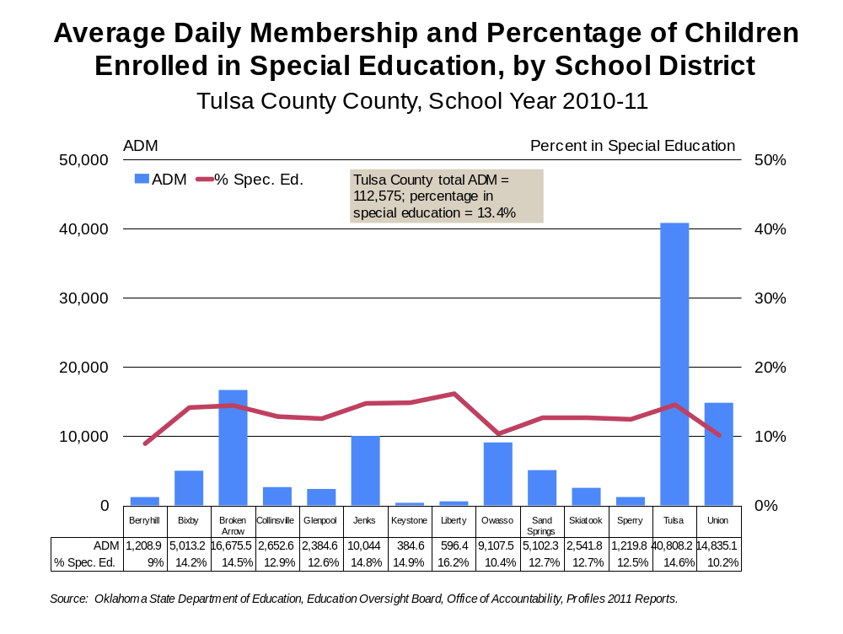
Child Indicators
Prepared by the Community Service Council of Greater Tulsa
Notes:
The average daily membership and percentage of children enrolled in special education is presented by school district for the 2010-2011 school year. Children identified as “special education” are placed on an “individual education plan”. Studies summarized by the federal government (AHRQ, 2003) indicated that the number of infants in the community born with low birth weight is a good indicator of the number of children who will be in need of special need services. All but one school district in Tulsa County exceed that indicator which is 8.3% in 2007. The Tulsa County average was 13.4%.
The implication for this disparity may be systematic or personal behaviors. The school district may not provide a school wide testing to determine special needs. Another dimension could be an increased acquired developmental or physical disability from environmental factors. The exact etiology is for community discovery.

Slide 27
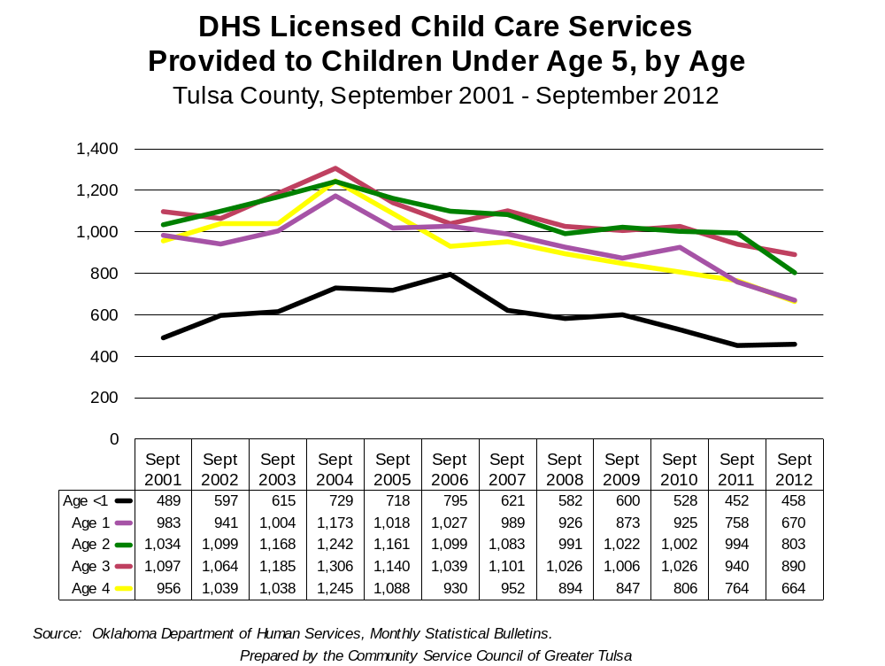
Child Indicators
Notes:
The Department of Human Services licensed child care services has decreased from 4,559 children less than 5 years old in September 2001 to 3,485 children in September 2012. This is an overall decrease of 23.6% from 2001 to 2012. Only 7.6% of the population of children less than 5 years old are in licensed child care.

Slide 28
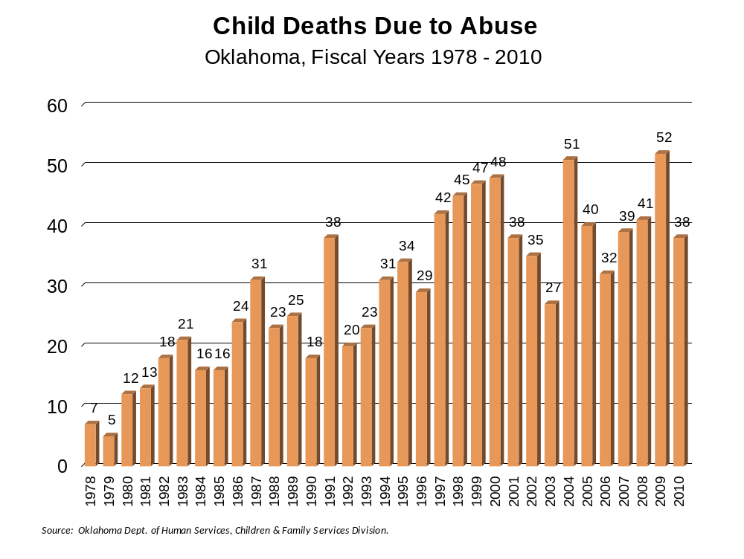
CHILD INDICATORS
Notes:
***Child Death and Near Death Addendum only available through 2010*** The number of child deaths due to abuse has fluctuated greatly since 2001, with peaks at 51 in 2004 and 52 in 2009. The two lowest rates were 27 in 2003 and 32 in 2006. In 2009, Oklahoma was 9 highest in child abuse deaths in the United States. Seventy five percent of all deaths are due to neglect rather than abuse. Several indicators are notable for the child deaths which include an increase in prevention programs (Children First, Healthy Families Oklahoma) and improved efforts at family interventions which risks are evident. The data is not usually represented by county.

Slide 29
Child Abuse & Neglect
In Tulsa County in FY 2011, there were 4,362 reports of child abuse and/or neglect accepted for investigation or assessment. 6,526 children were involved in these reports (duplicated count).
1,023 children were confirmed victims of child abuse and/or neglect. 115 were abused, 785 were neglected, 123 were victims of both abuse and neglect.
Nearly 7 of every 1,000 children in Tulsa County are victims of abuse and/or neglect. In Oklahoma, the rate is just under 9 of every 1,000 children.
Oklahoma ranks #35 in the nation in the rate of children who are victims of abuse and/or neglect.
Parents make up 77.3% of all perpetrators, followed by “no relation” at 6.3%, step-parents at 6.2%, and grandparents at 3.3%.
Substance abuse is a major contributing factor to child neglect.
Child Indicators
Prepared by the Community Service Council of Greater Tulsa
Notes:
Child abuse and neglect is a significant indicator of family stress than contributes to greater potential for adverse effects in social and emotional adjustment of children in school. Seven of 1,000 children in Tulsa County compared to 9 of every 1,000 children in Oklahoma are victims of abuse and/or neglect.

Slide 30
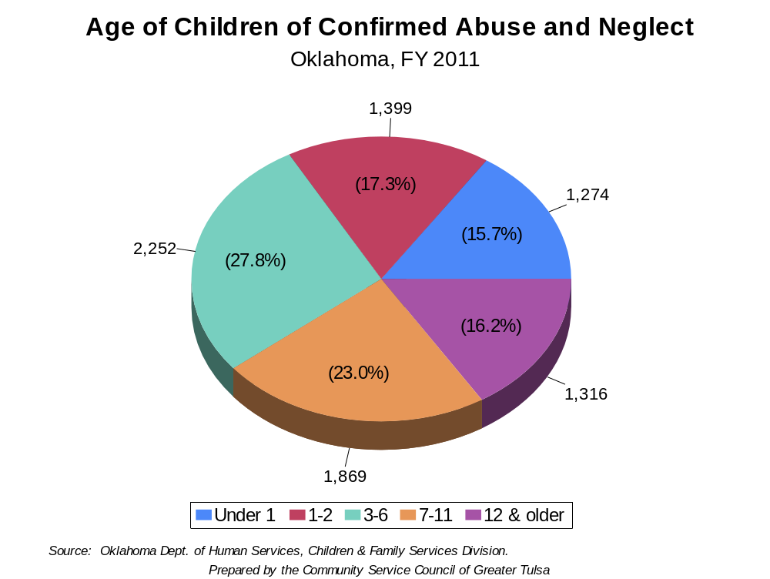
Child Indicators
Notes:
The significant portion of children abused were too young to complain or avoid their perpetrator with 15.7% under 1 and 17.3% of children 1 to 2 years old.

Slide 31
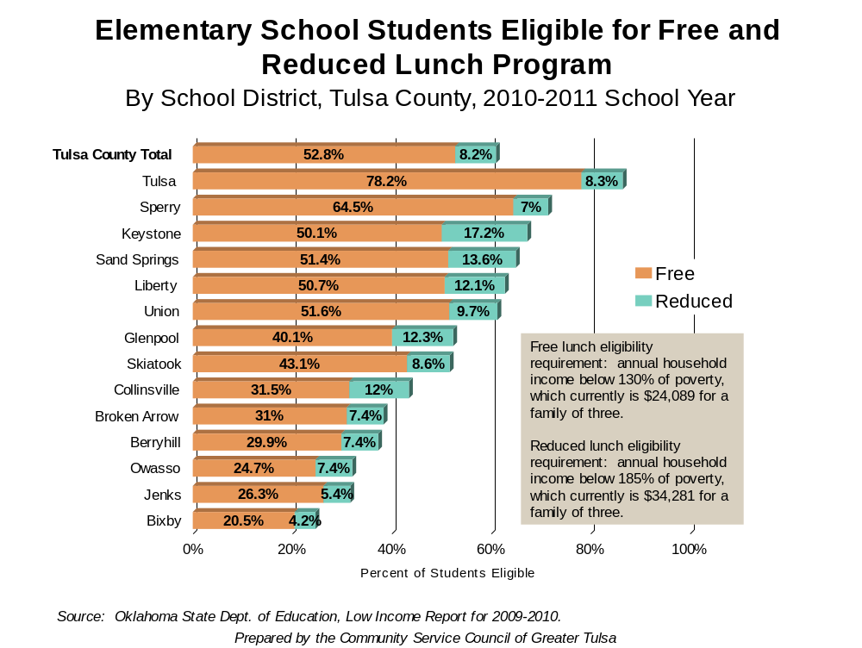
Child Indicators
Notes:
Elementary school students eligible for free and reduced lunch is a good indicator of family status. Note that no school district in Tulsa County is without low income families. Poverty is disseminated in the county with peaks in the Tulsa, Sperry, Keystone, and Sand Springs communities.

Slide 32
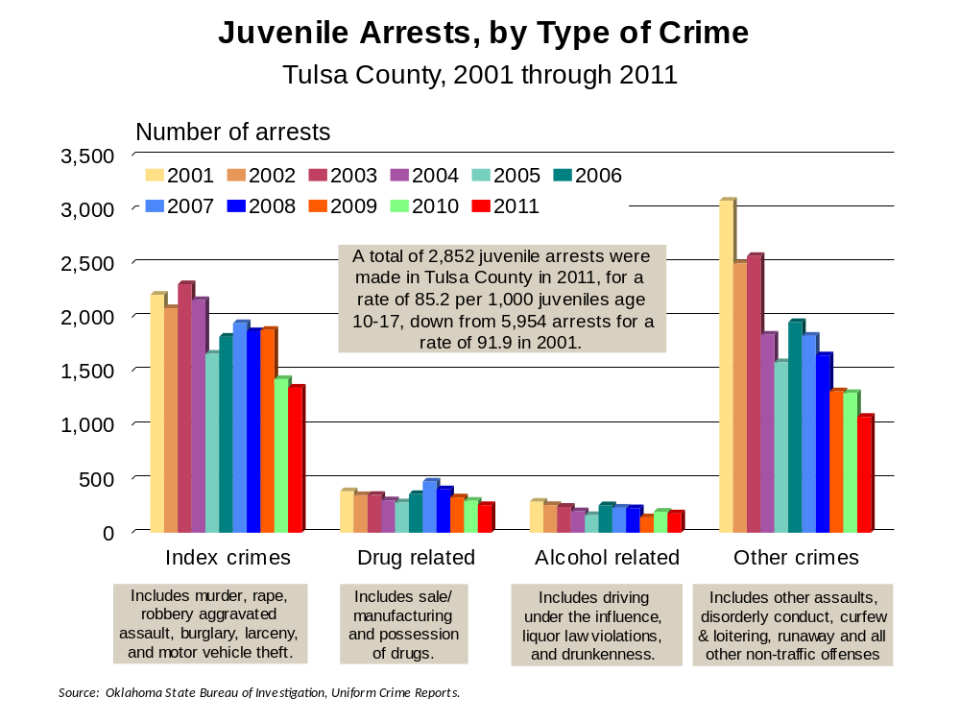
Child Indicators
Notes:
Juvenile arrests for Index Crimes and Other Crimes in Tulsa County from 2001 to 2011 declined overall, with significant fluctuation from 2004 to 2006. A total of 2,852 juvenile arrests were made in Tulsa County in 2011 for a rate of 85.2 per 1,000 juveniles age 10-17, a change from 5,954 arrests and a rate of 91.9 in 2001.

Slide 33
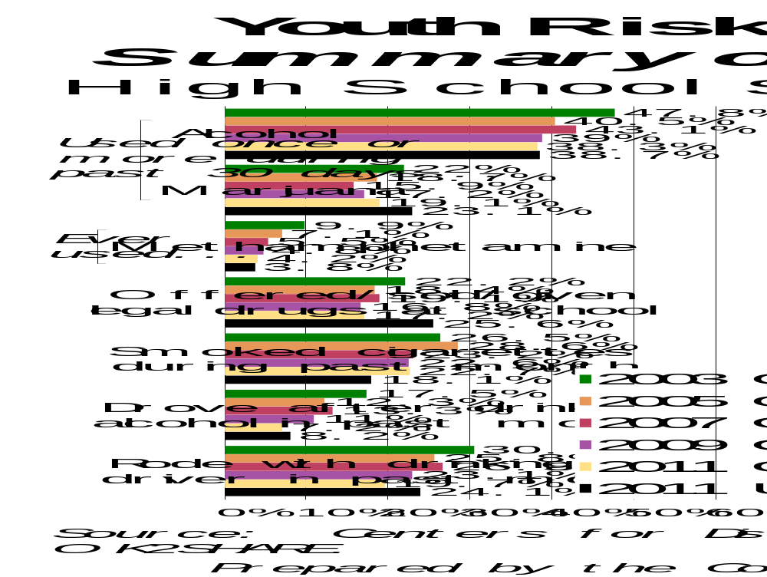
Child Indicators
Notes:
Adverse childhood experiences of children are systematically assessed in the Youth Risk Behavior Survey conducted by the Oklahoma State Department of Health. This study assesses middle and high school students for risk behaviors. The next 2 charts are synopsis of the Youth Risk Behavior Survey results from Oklahoma and the United States (US). Tulsa high school students. The results indicated decreases in “methamphetamine use ever, smoked cigarettes on 20+ days during the past month, used any tobacco products during the past month and drove after drink alcohol in the past month.”

Slide 34
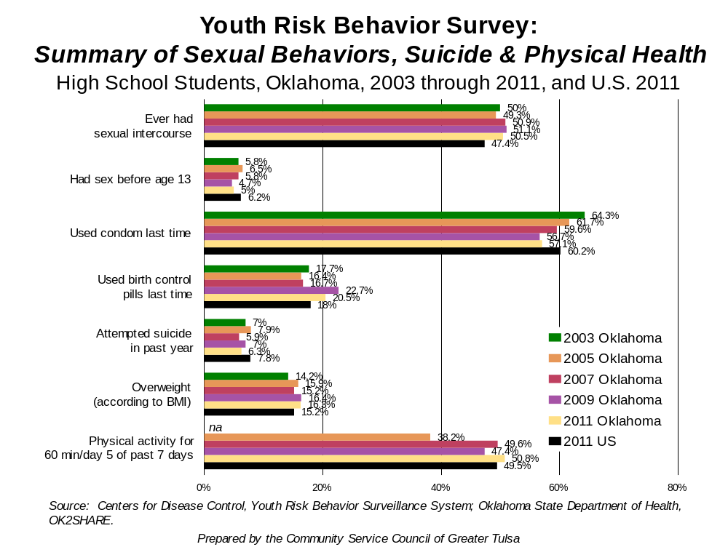
Child Indicators
Notes:
Risk factors regarding poor physical health were greater for at risk of overweight, and overweight as well as insufficient moderate physical activity.

Slide 35
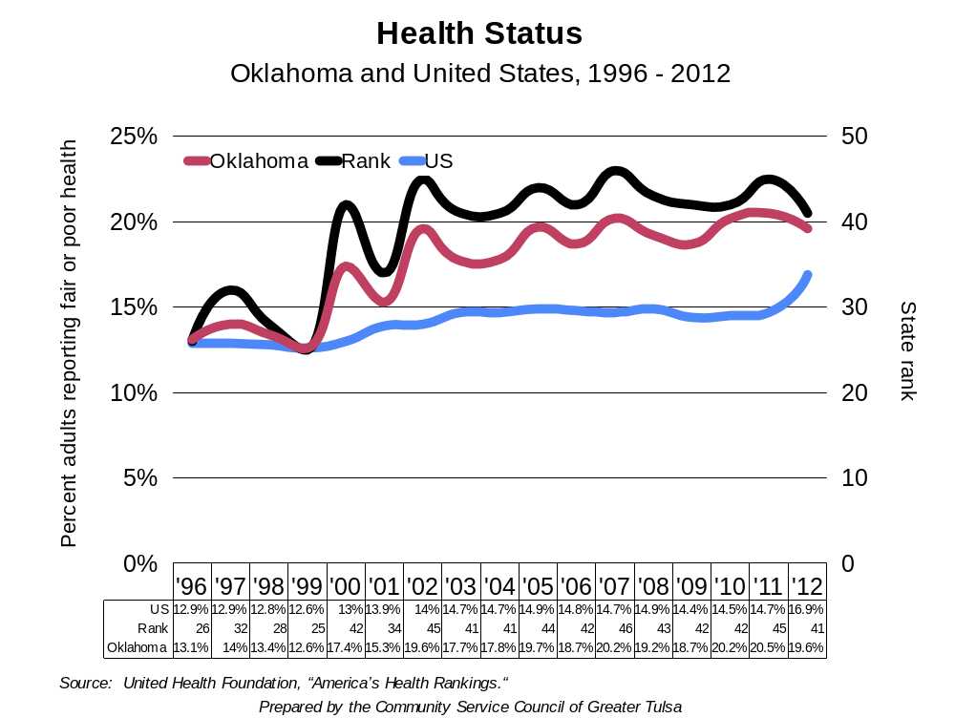
Child Indicators
Notes:
The overall health status for Oklahoma compared to the US indicates Oklahomans are in poor health. Oklahoma is 41 worse out of 50 in overall health.

Slide 36
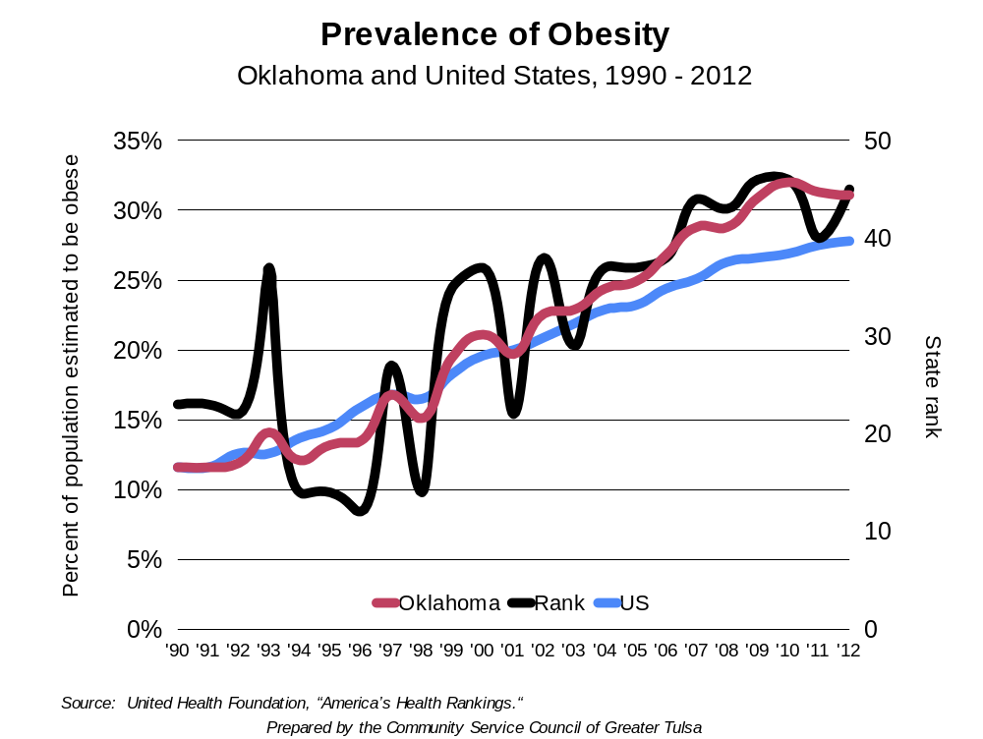
Child Indicators
Notes:
Contributing to poor health is the high rate of obesity with over 31.1% of Oklahoma adults considered obese compared to 27.8% of U.S. adults. This is up from 11.6% of Oklahoma and U.S. adults in 1990. Oklahoma is ranked 45th worst in obesity in the U.S.

Slide 37
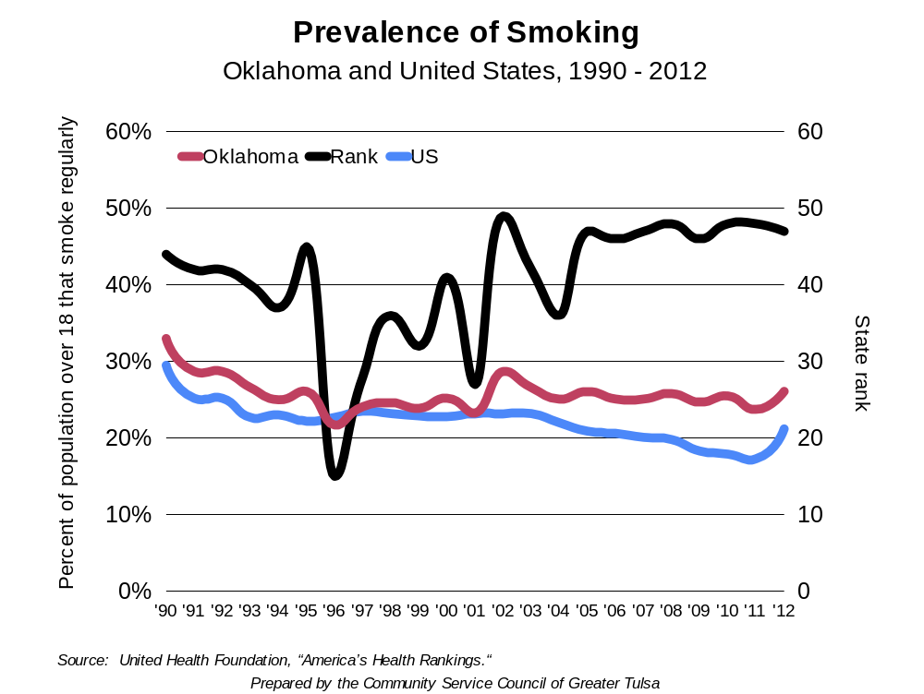
Child Indicators
Notes:
Another contributing factor to poor health is the prevalence of smoking. In 2012, 26.1% of Oklahomans compared to 21.2% of U.S. adults were smokers. This is down from 33% in 1990 for Oklahomans and 29.5% fro the US. Oklahoma is ranked 47th worse in smoking for the population over 18 years.

Slide 38
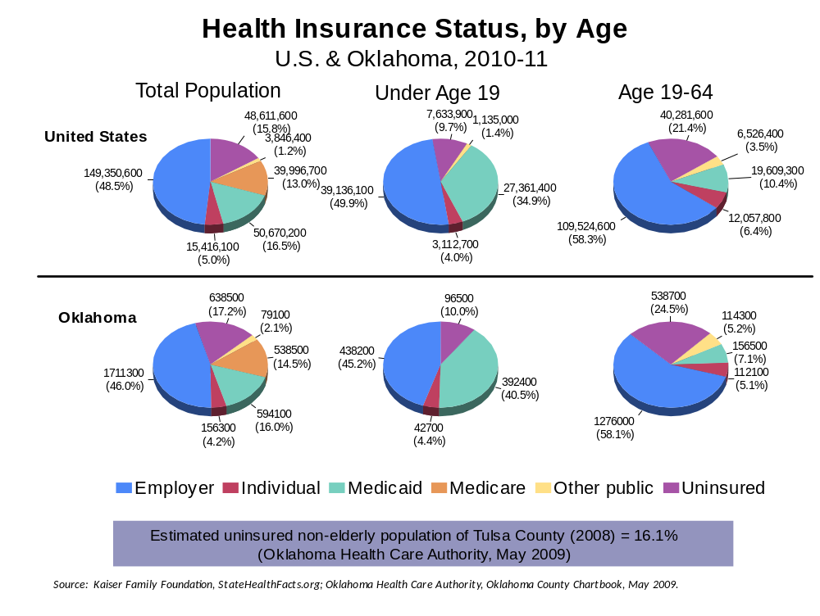
HEALTH INDICATORS
Notes:
38
The health insurance status by age reveals a large number of Oklahomans are uninsured with 17.2% for the total population, 10.0% for children under age 19, and 24.5% for people aged 19-64 years. The lack of health insurance correlates with the lack of preventative and acute health care intervention leading to more significant health problems. The lack of health insurance is a factor in Oklahoma’s high premature death rate.

Slide 39
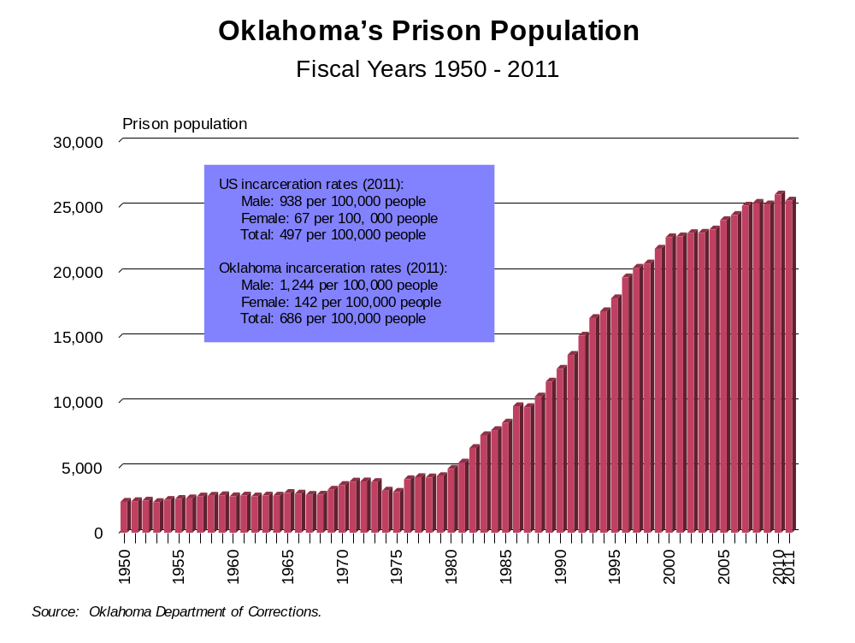
Crime & Incarceration
Prepared by the Community Service Council of Greater Tulsa
Notes:
39
Oklahoma’s prison population was relatively stable until 1980 when laws passed to curb illegal drug use came into effect. In 2011, approximately 0.7% of the total Oklahoma population was incarcerated compared to only 0.5% for the U.S.

Slide 40
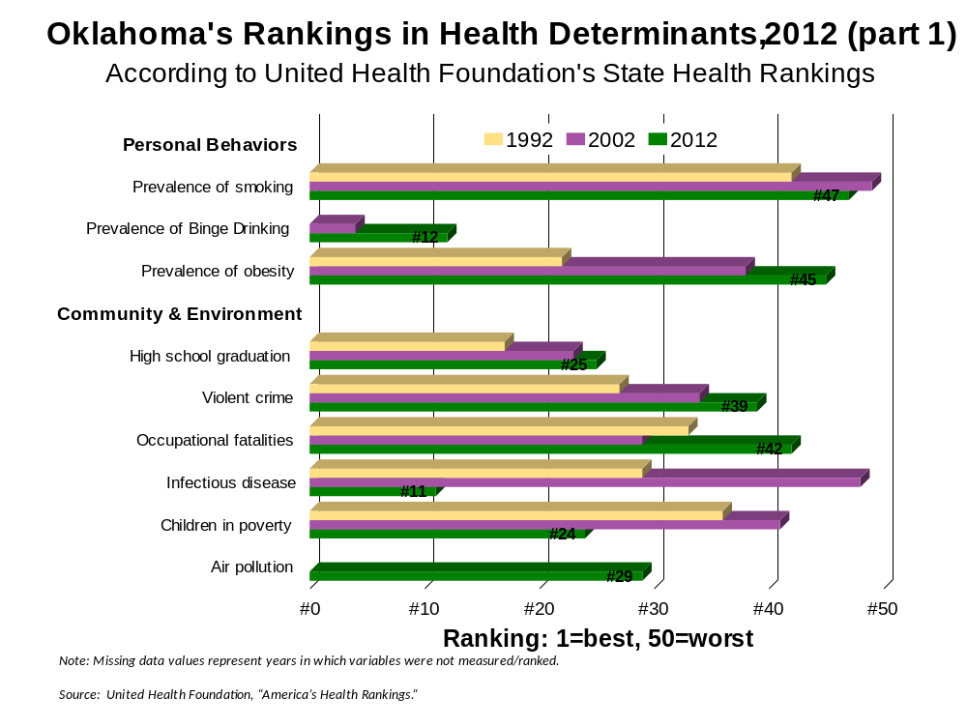
HEALTH INDICATORS
Notes:
The United Health Foundation State Health Rankings are used by industry in planning expansion and/or relocation to other states. The ranking is 1 for best and 50 for worst. Oklahoma rankings are in the bottom 25% on 5 of 9 risk factors in personal behavior and community health. Oklahoma has made improvements in high school graduation, infectious disease control, and children in poverty for the last 21 years.

Slide 41
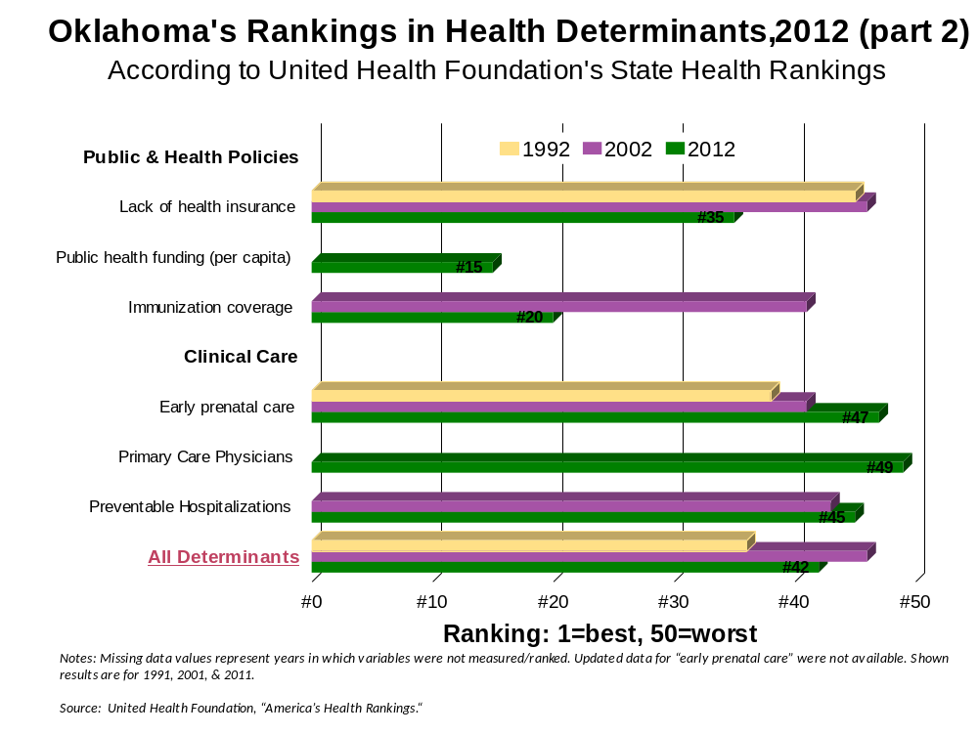
HEALTH INDICATORS
Notes:
The United Health Foundation State Health Ranking for outcomes reveals a more dire picture with an overall ranking in all categories of 42 in 2012.

Slide 42
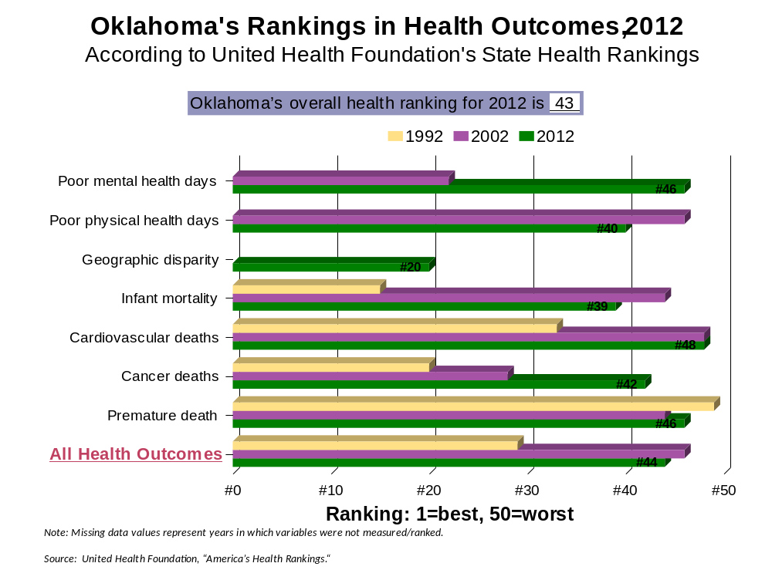
HEALTH INDICATORS
Notes:
Oklahoma is ranked the 43th worse in the US in all health outcomes.

Slide 43
Adverse Childhood Experiences tulsa County Rankings
Parental separation or divorce 49
Incarcerated household member 76
Mentally ill household member 77
Substance abusing household member 76*
Violence against mother 57
Psychological, physical & sexual abuse 12
Emotional & physical neglect 4
Overall ranking 31
Rankings: 1 = best, 77 = worst
*Indicates a tie with at least one other county
Child Indicators
Source: Oklahoma 2009 KIDS COUNT Factbook (2005-2007 rankings), Oklahoma Institute for Child Advocacy
Notes:
***Could not find ranking data more up-to-date than this*** Based on the Adverse Childhood Experiences risk factors, Tulsa County has a moderate likelihood that children residing in the county will experience adversity and have increased risk for adult disability and social problems. Tulsa County is ranked 31 of 77 counties in the risk (77 being worst) by the Oklahoma Institute for Child Advocacy (2006)

Slide 44
…In Summary

Slide 45
Community Profile 2013 tulsa County
Prepared by the Community Service Council of Greater Tulsa
January 2013
…is available on our website:
www.csctulsa.org
Presentation are available from
Jan Figart
jfigart@csctulsa.org
Notes:
This presentation and report was prepared by Jeremy Aragon, MSW, Melanie Poulter, MA and Jan Figart, MS, RN.

