Slide 1
What Is Christianity?

Slide 2
What
is
your
answer?

Slide 3
Christianity
is the sum total of everything that has been and is being done
in the name of Jesus.

Slide 4
Christianity
or
Christianities?

Slide 5
Who do you say Jesus is,
and
what are you doing
in his name?

Slide 6
Handle Vipers
Mark 16:18
Acts 28:3

Slide 7
Prosperity Gospel
God wants everyone to be wealthy (picture of Creflo Dollar and another of John Oliver’s sendup of prosperity gospel preachers, Our Lady of Perpetual Exemption)

Slide 8
Providing Protection for Neighbors
OK Christians provide a human shield for Muslims a the state capitol

Slide 9
Old New England Church
Full of decorum, and little else

Slide 10
Old New England Church, Revived
Two pictures from First Unitarian Church, Boston

Slide 11
African Churches
Joyous offerings
Night-long healing services
Violently anti-gay

Slide 12
Sexuality and gender have strictly defined rights and wrongs
“Biblical definition of marriage”—
man and woman in a lifelong covenant,
or that plus polygamy and women are the property of men, and marriages are for strategic alliances?
Oklahoma Wesleyan and Union U. Quit CCCU Over Same-Sex Marriage Moves

Slide 13
Do this in remembrance of me
Orthodox priest celebrates the Eucharist
Disciples—Clown communion service

Slide 14
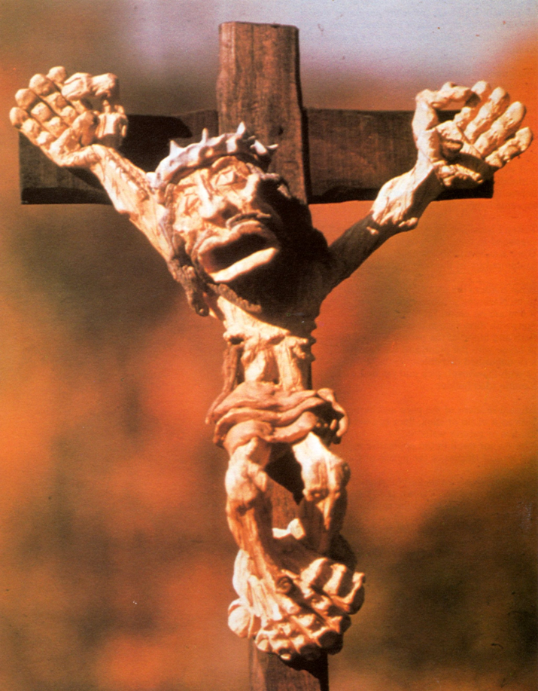
Cross
Great suffering, who is present with those who suffer greatly
Perfect sacrifice, perfect priest

Slide 15
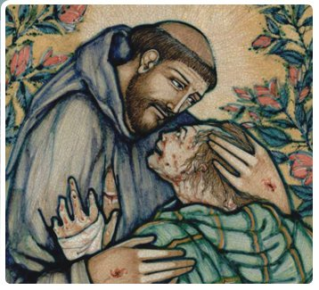
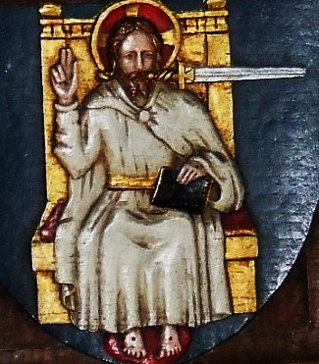
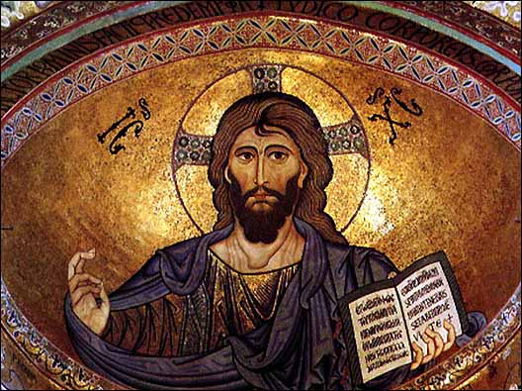
Humility and Power
St. Francis
Christ the Pantocrater

Slide 16
Les Miserables?
Law and order (Javert)
Compassion for human misery (Jean Valjean)

Slide 17
Your empire come: dominionists
Picture of the seven sections of life persons at this end of the Christian spectrum hope to dominate

Slide 18
Your empire come: separatists
Picture of an Amish family

Slide 19
Your empire come: USA
A civil religion, Christianity used in service of American values, never as a critic of American values

Slide 20
Your empire come: conflict and harmony
Justice and mercy for “the least of these” is the plumbline

Slide 21
Jesus founded the church and replaced Judaism

Slide 22

Jesus led a renewal movement in Judaism

Slide 23
Homosexuality: perversion, or among the diverse gifts of God
Bakers and photographers
Clergy

Slide 24
Billboard
Jesus loves you and will burn you in hell if you don’t love Jesus

Slide 25
God is love. Period.

Slide 26
We must
risk
an interpretation.

